Slide 1
Chapter 9: Environment, Recreation, and Open Space
Amelia Schwartz, Associate Planner
May 15, 2024

Slide 2
Today’s Work Session
Chapter 9 - Environment, Recreation, and Open Space
Suggested edits and a “thumbs up” to bring it to a public hearing with the entire plan
Public Comments and Stakeholder Engagement
Next Steps​

Slide 3
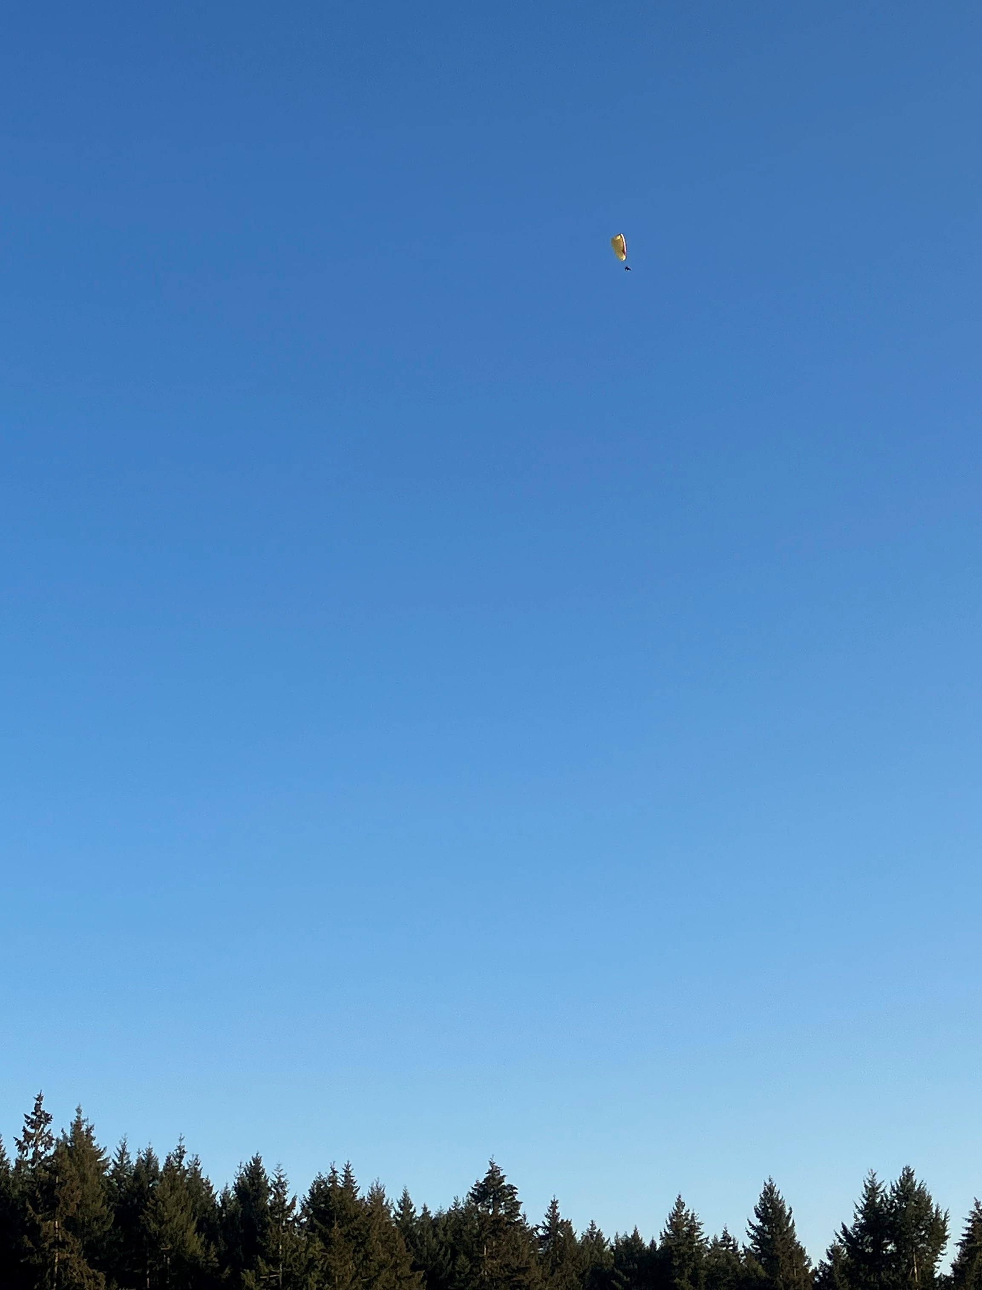
Chapter 9: Environment, Recreation, and Open Space
Covered in this Chapter:
Environment
Hazards
Recreation
Open Space

Slide 4
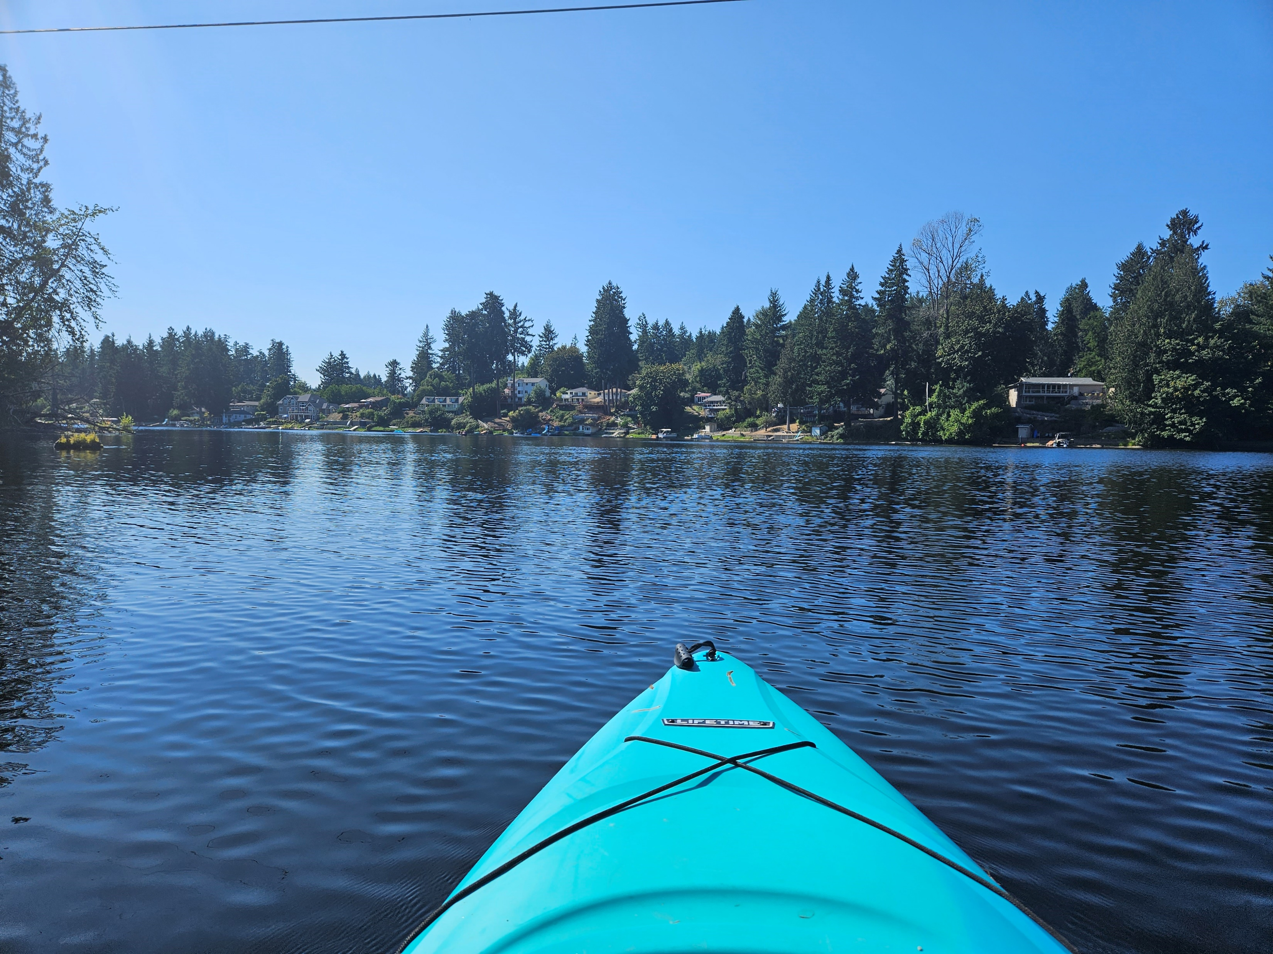
Chapter 9: Environment
Survey Responses: “…protect the natural environment for wildlife, water quality, and climate reasons and aesthetic/recreation opportunities.”
New Forestry Policies
Pull in data from tree canopy analysis
Align with Thurston Climate Mitigation Plan
Support working forestland conservation goals
Expanded Water Quality Policies
Promote water quality and availability protection practices
Updated Habitat Conservation Policies
Align with adopted Habitat Conservation Plan
Support habitat conservation goals

Slide 5
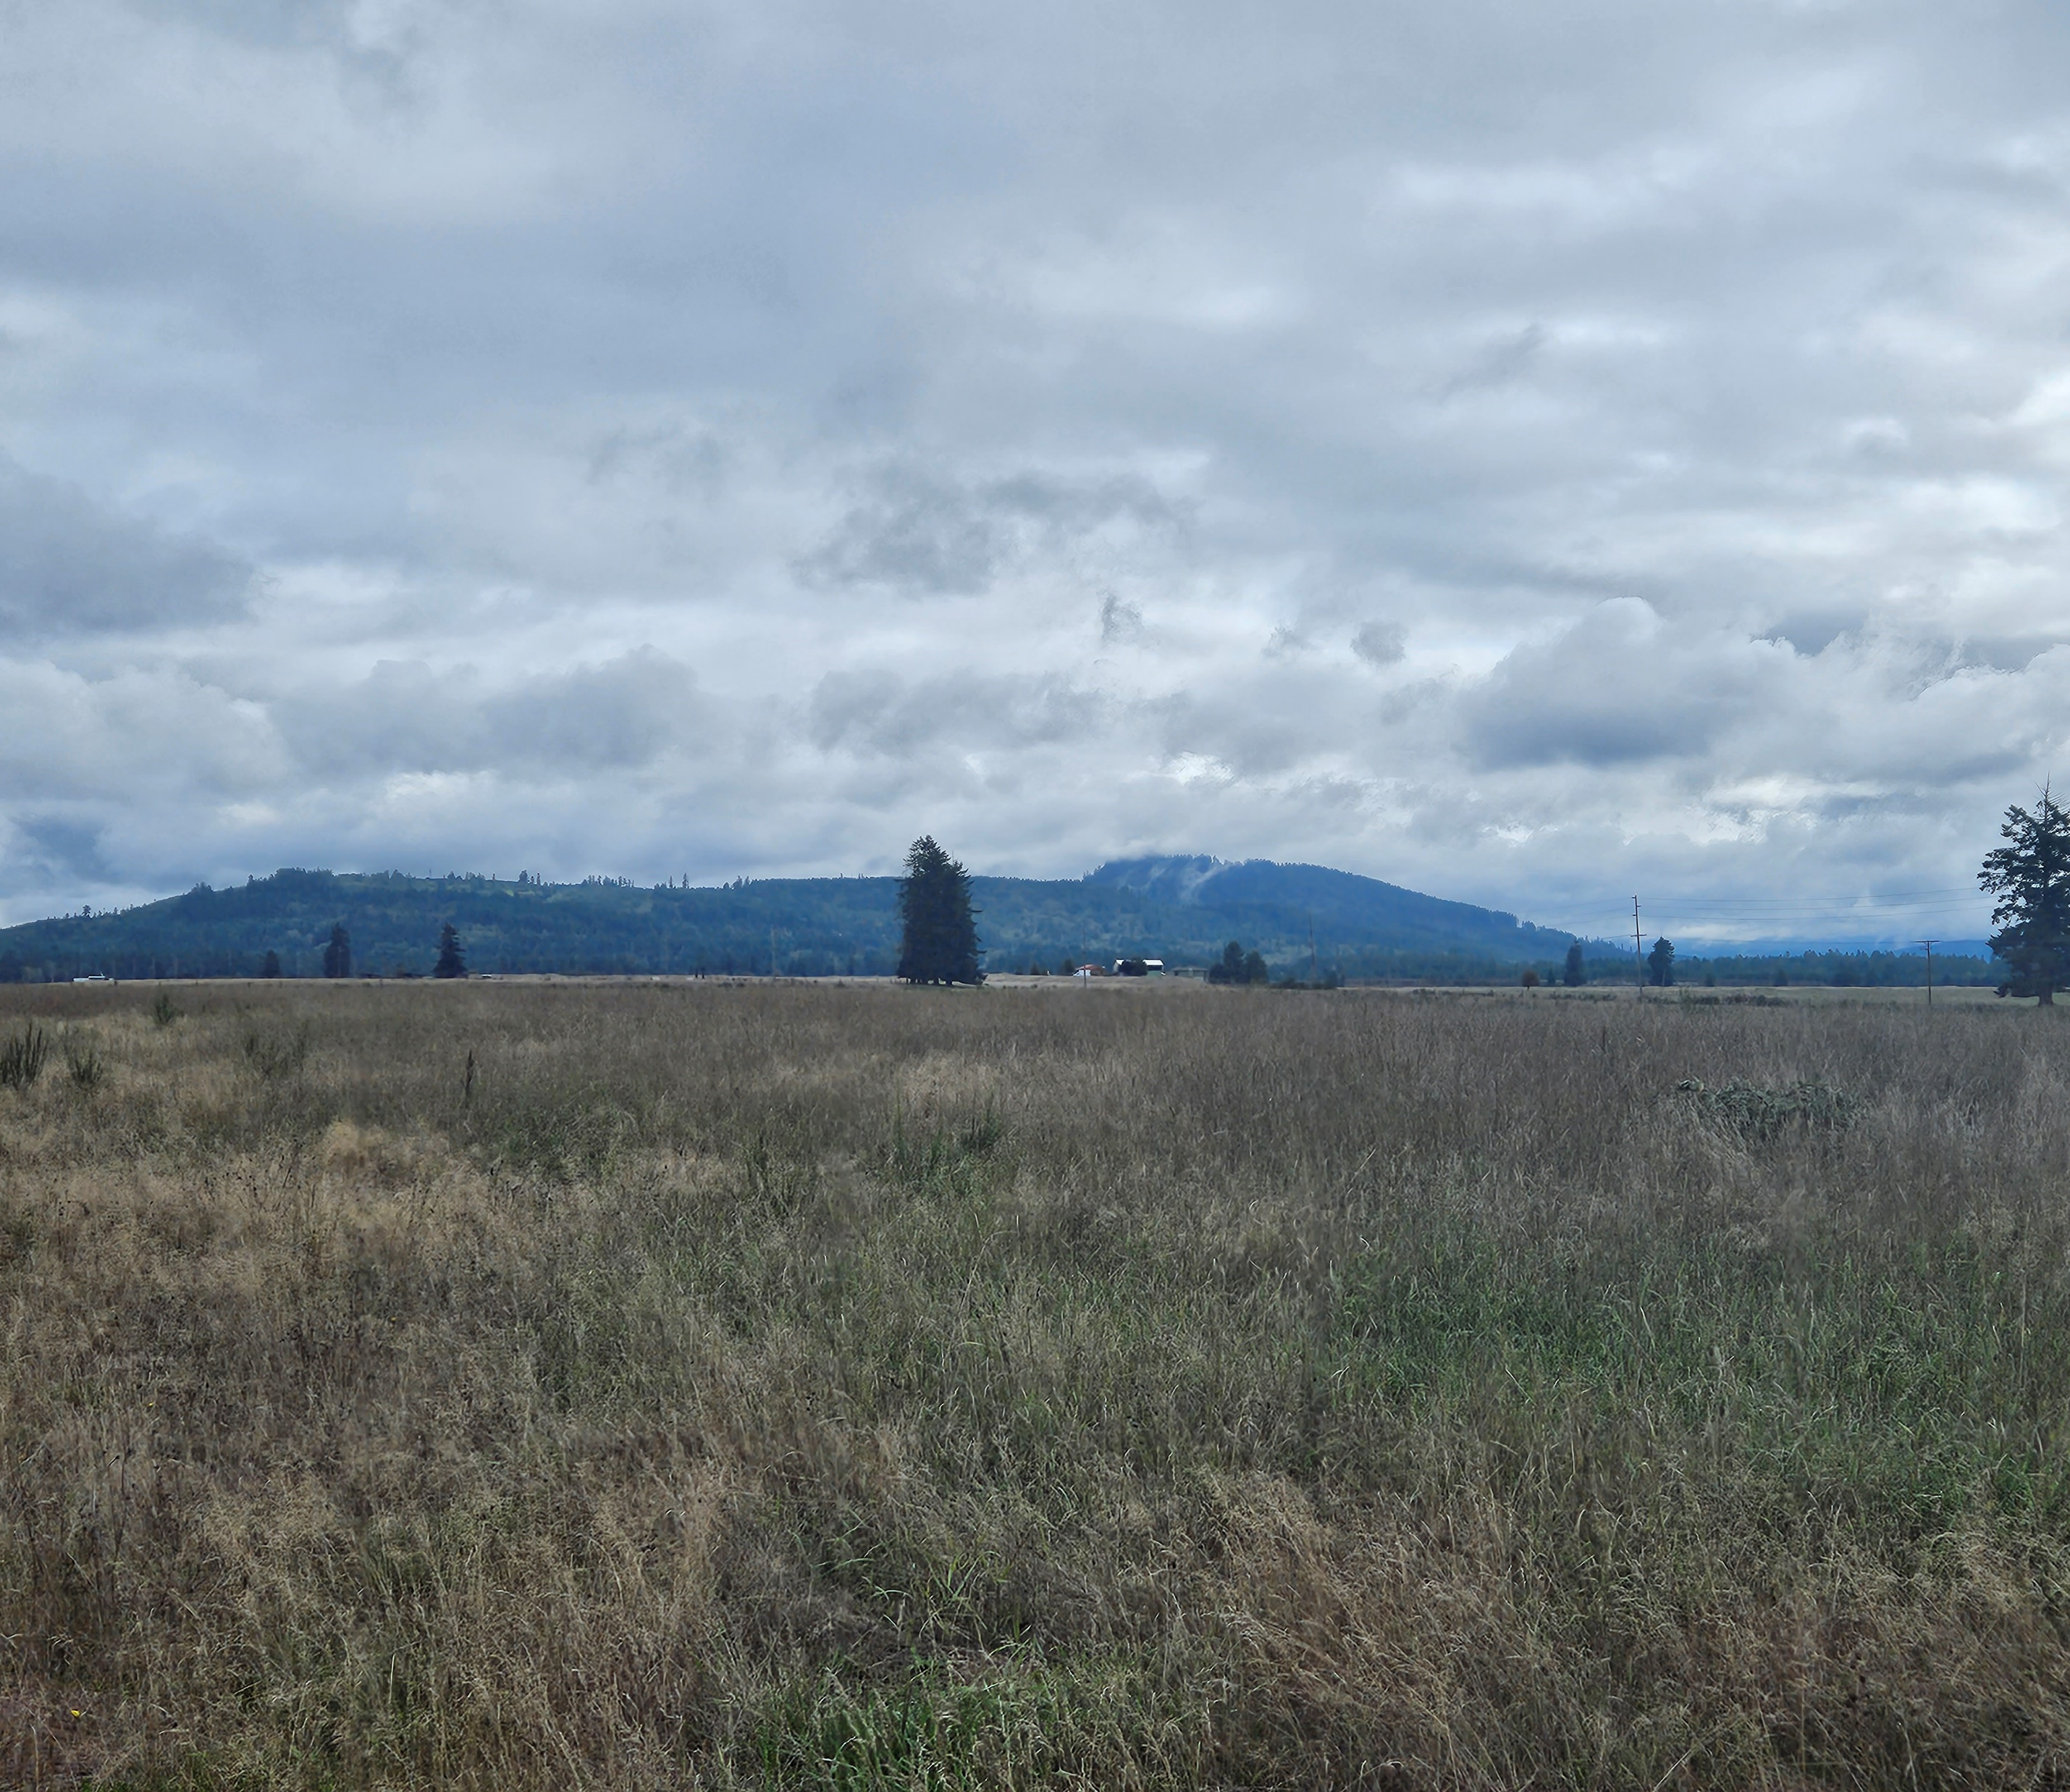
Chapter 9: Hazards
Survey Responses: “…incorporate climate mitigation and resilience information, policy, and metrics; hazards planning; and environmental justice priorities”
Updated policies to reflect new Hazards Mitigation Plan
New language to update CAOs using geologic hazard data
Prioritize resources to protect underserved communities in hazards
Prepare to move policies to new Climate Element
New language to enforce required provisions for fire safety

Slide 6
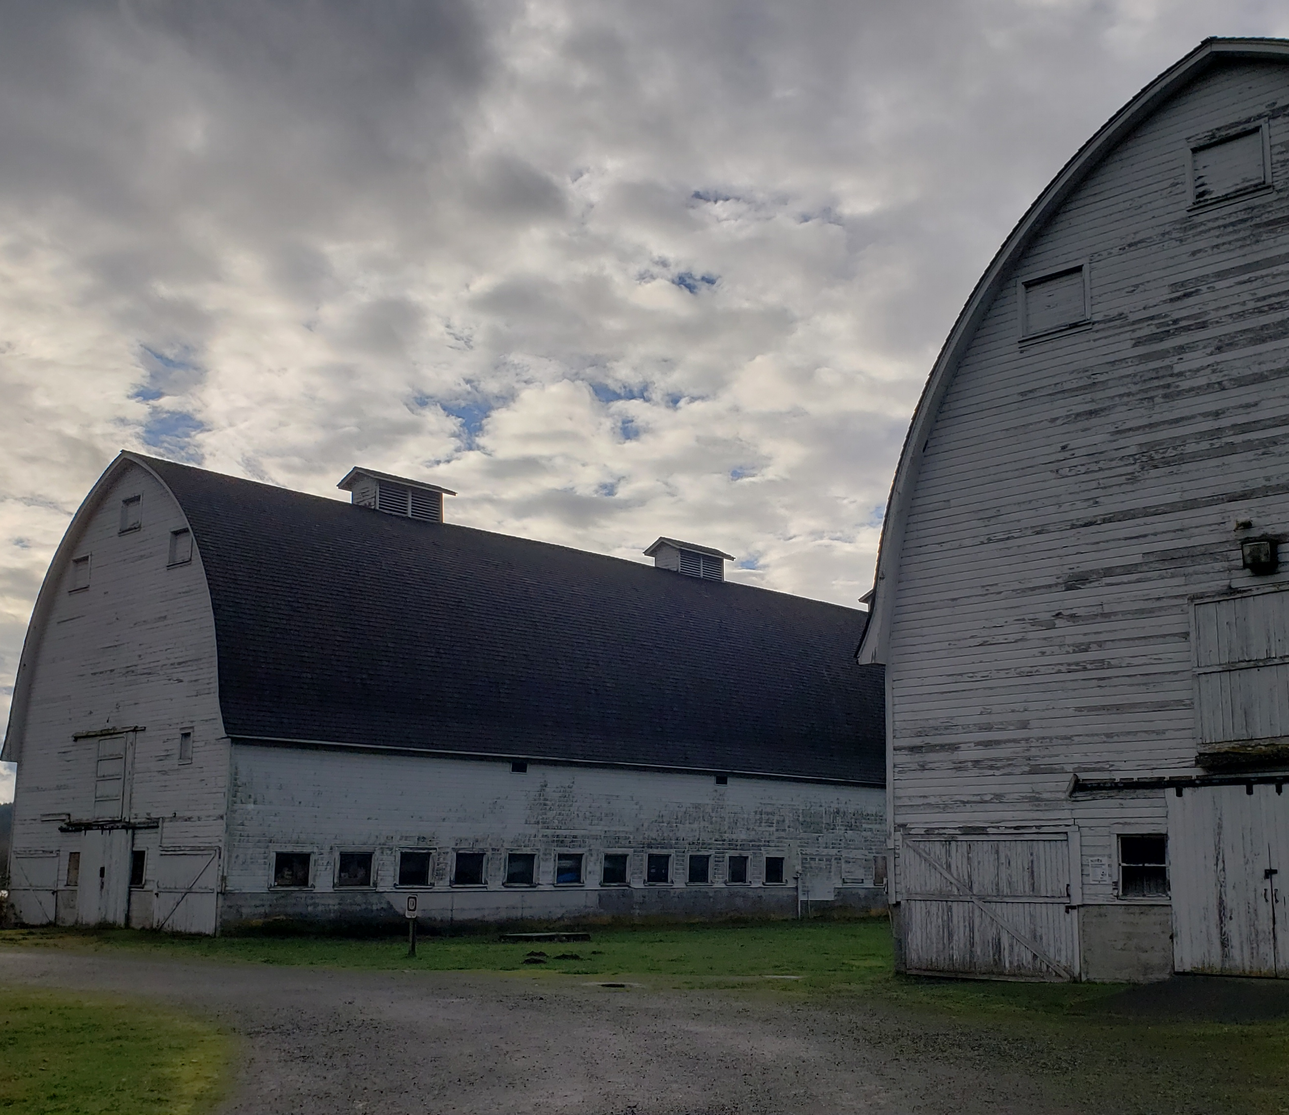
Chapter 9: Recreation
Survey Responses: “Thurston County is building a competitive advantage with its trails.”
“Increase parks.”
New policies to support expanded recreation planning and administration
Updated parks information and level of service data
Improve awareness of park rules and regulations through improved signage policy
5/15/2024
6

Slide 7
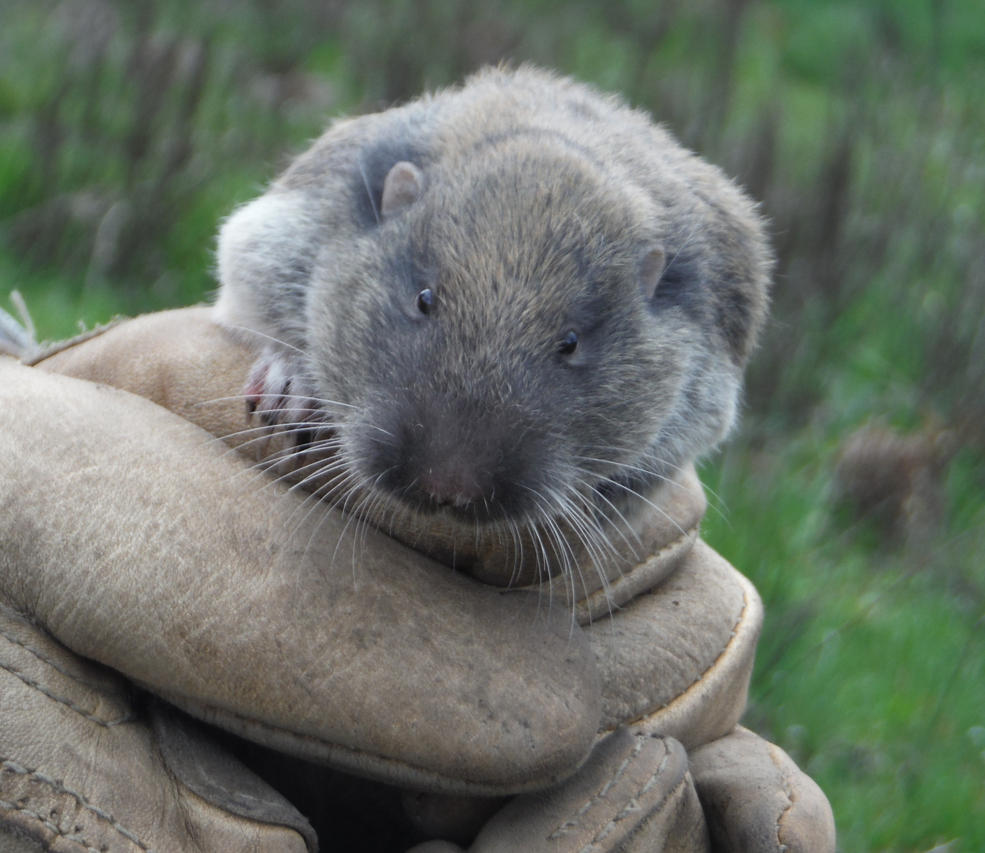
Chapter 9: Open Space
Updated policies to support greenspace connectivity and partner collaboration
Add information on open spaces and wildlife corridor connectivity
Consider open and green spaces when evaluating land use and acquisition opportunities
New map (E4, next slide!) to show connections and open and green spaces within Thurston County
Survey Responses: “Preserve open space.”

Slide 8
Open and Green Space Corridor Map
Identifies areas where government lands, forests, parks, and waterbodies connect
Is not regulatory
Can be used with habitat and open/green space connectivity efforts

Slide 9
Public Comment
Thurston 2045 Survey
Environment: 12 Comments Topics Included: Reduce/Slow Growth, Remove Pollution, Improve Wildfire Resilience, Incorporate Habitat Connectivity Corridors, Mitigate Flooding, Protect/Restore Environmental Quality, Improve Energy Efficiency Options.
Open Space & Recreation: 10 Comments Topics Included: Increase Parks And Trails, Preserve Open Space, Reduce/Slow Growth, Protect/Improve Water Quality, Include Climate Mitigation And Resilience Language

Slide 10
Stakeholder Engagement
Local Tribes
Water Resources
Emergency Management
Public Works
Environmental Health
Surface and Stormwater Advisory Board

Slide 11
Upcoming Thurston 2045 Meetings
June 5, 2024
Chapter 2: Land Use (Non-housing policies)
Chapter 3: Natural Resource Lands
June 26, 2024 (Special Meeting)
Chapter 4: Housing & Equity

Slide 12
Ways to Engage!
Visit the Thurston 2045 Webpage
http://thurston2045.org/
Sign up for Email Updates
https://lp.constantcontactpages.com/su/SEKnFSp/Thurston2045
Comment on the Project
https://www.surveymonkey.com/r/RLB63K9
Notes:
Will verbally go into detail for each bullet item

Slide 13
Thank You!
Amelia Schwartz, Associate Planner

